Slide 1
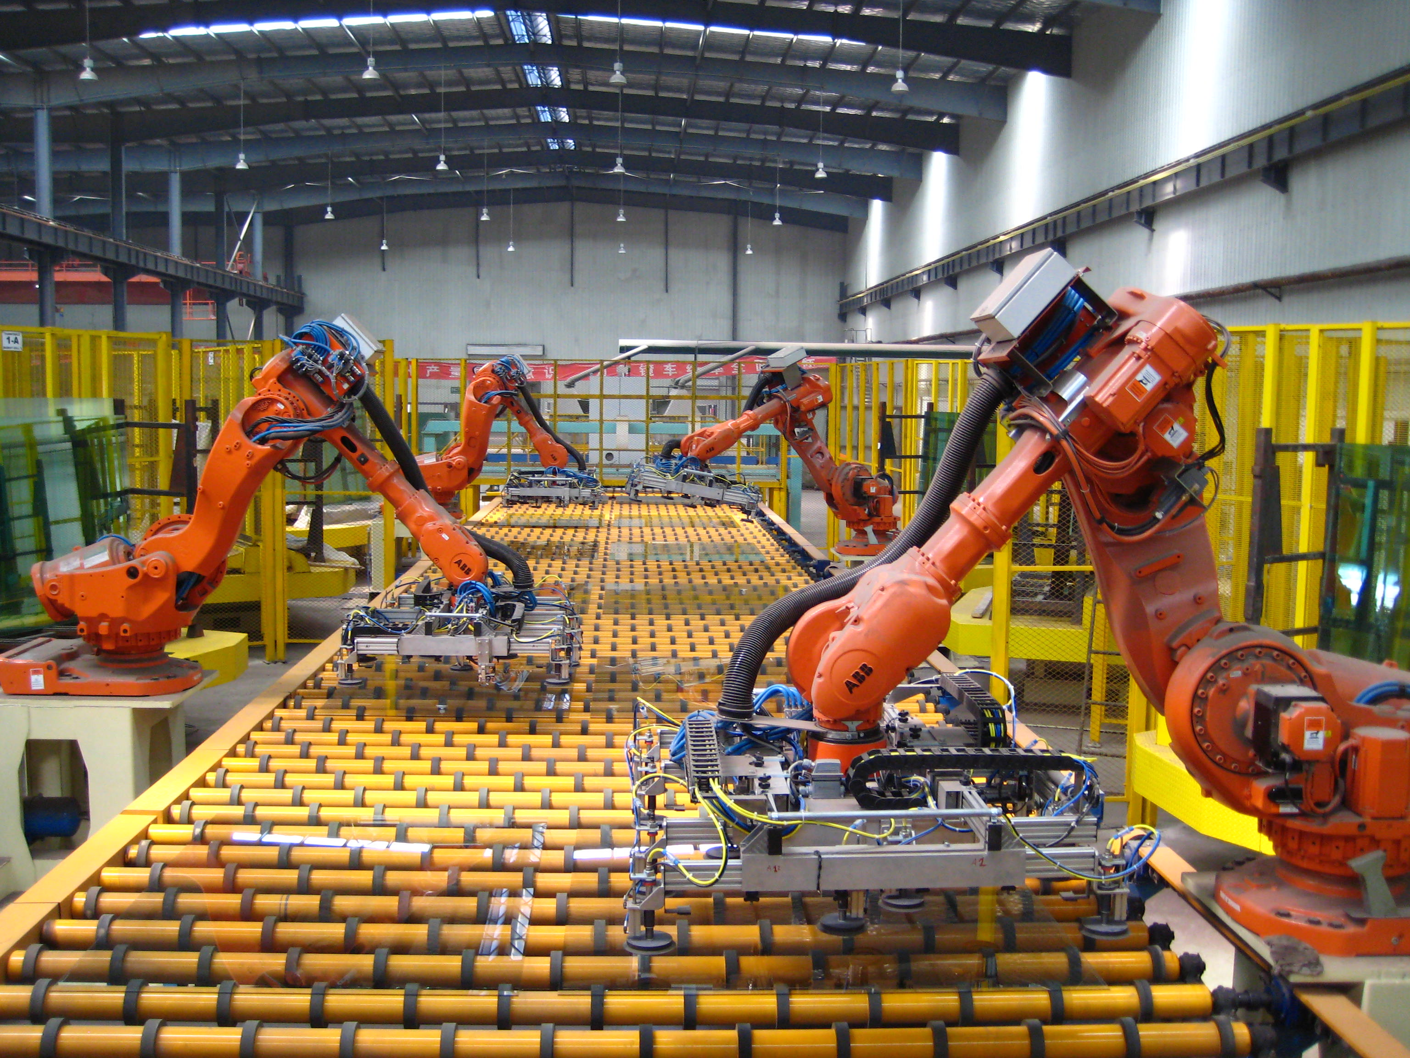

WEEK 4 + WEEK 5
Edge Hill University
Advanced Robotics and AI CIS3137
Dr. Ammar Al Mhdawi
Ammar.Al-Mhdawi@edgehill.ac.uk

Slide 2
Key to Success
Attendance
Pay attention to lectures and keep extra notes
Ask questions
Effort
Do homework on your own. It’s ok to ask others, but make your own effort
Read extra material on your own. Wealth of information available (library books, online articles, research papers)
Consistency
Keep up with the class pace

Slide 3
Class Expectations
Class participation – Your input is needed for good discussion
Keep up with reading material
Complete assignments and projects on time
Submit clean, organized, and concise CW reports

Slide 4
Contents
1
Machine Learning: Regression, Clustering, and Classification
2
Summary
3
Exercise Task

Slide 5
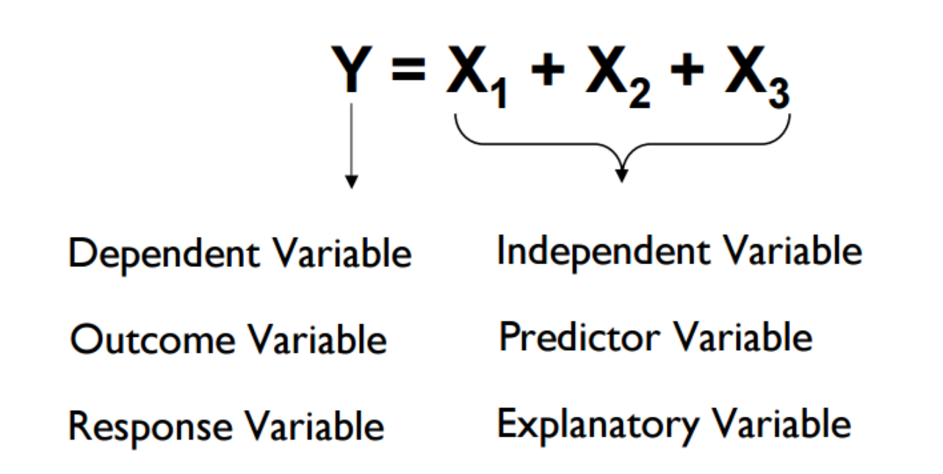
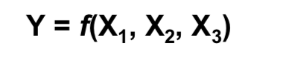
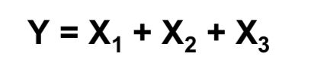
1
Machine Learning: Regression, Clustering, and Classification
Linear Regression
Regression is a method to predict a target variable by fitting the best linear relationship between the dependent and independent variable.
Suppose we want to model the dependent variable Y in terms of three predictors, X1, X2, X3. Typically, will not have enough data to try and directly estimate f
Therefore, we usually have to assume that it has some restricted form, such as linear

Slide 6
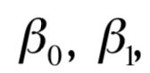
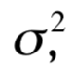
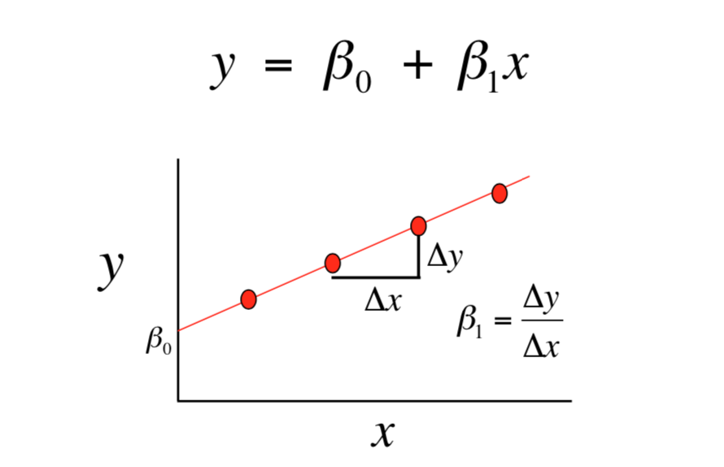
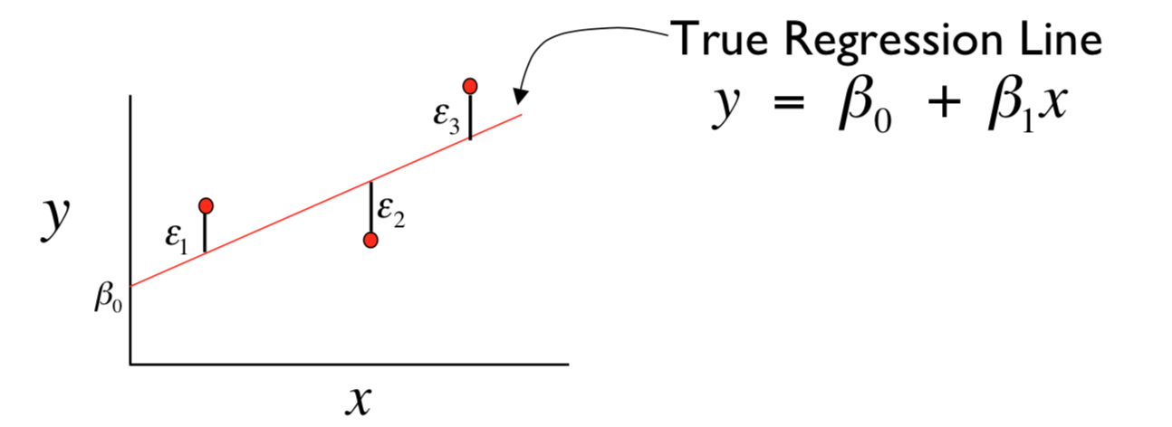
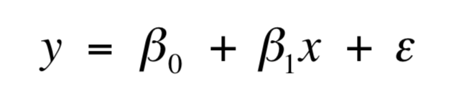
1
Machine Learning: Regression, Clustering, and Classification
Linear Regression
Understanding the relationship between related variables in a nondeterministic fashion
There exists parameters. and such that for any fixed value of the independent variable x, the dependent variable is related to x through the model equation
Least Squares Method: The best fit is done by making sure that the sum of all the distances between the shape and the actual observations at each point is as small as possible. The fit of the shape is “best” in the sense that no other position would produce less error given the choice of shape.

Slide 7
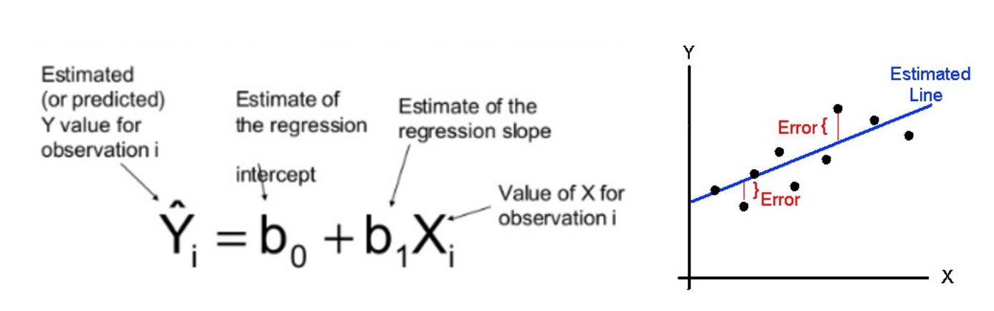
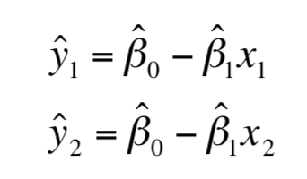
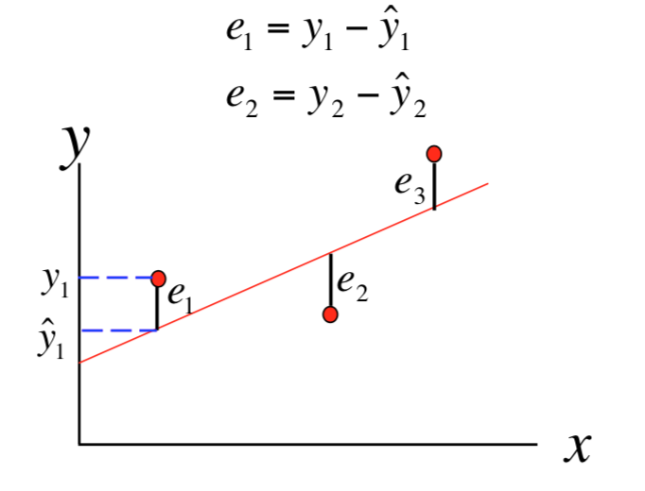
1
Machine Learning: Regression, Clustering, and Classification
Linear Regression
calculating the error value between prediction and real values
Predicted, or fitted, values are values of y predicted by the least- squares regression line obtained by plugging in x1,x2,...,xn into the estimated regression line
Residuals are the deviations of observed and predicted values

Slide 8
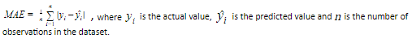
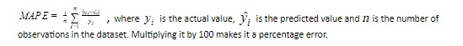
1
Machine Learning: Regression, Clustering, and Classification
Linear Regression
Performance of regression:
The performance of the regression model can be evaluated by using various metrics like MAE, MAPE, RMSE, R-squared etc.
Mean Absolute Error (MAE)
By using MAE, we calculate the average absolute difference between the actual values and the predicted values.
Mean Absolute Percentage Error (MAPE)
MAPE is defined as the average of the absolute deviation of the predicted value from the actual value. It is the average of the ratio of the absolute difference between actual & predicted values, and actual value.

Slide 9
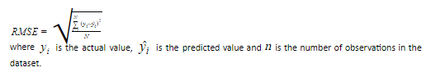
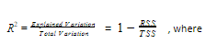
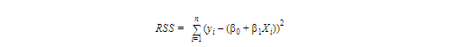
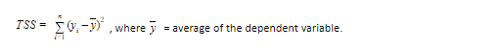
1
Machine Learning: Regression, Clustering, and Classification
Linear Regression
Performance of regression:
Root Mean Square Error (RMSE)
RMSE calculates the square root average of the sum of the squared difference between the actual and the predicted values.
R-squared values
R-square value depicts the percentage of the variation in the dependent variable explained by the independent variable in the model.
RSS = Residual sum of squares: It is the measure of the difference between the expected and the actual output. A small RSS indicates a tight fit of the model to the data. It is also defined as follows:
TSS = Total sum of squares: It is the sum of errors of the data points from the mean of the response variable.

Slide 10
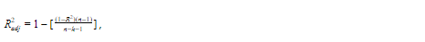
1
Machine Learning: Regression, Clustering, and Classification
Linear Regression
Performance of regression:
Adjusted R-squared values
R² value ranges from 0 to 1. Higher the R-square value better the model. The value of R²increases if we add more variables to the model irrespective of the variable contributing to the model or not. This is the disadvantage of using R².
The disadvantage of R² is fixed by the Adjusted R² value. Adjusted R² value will improve only if the added variable is making a significant contribution to the model. Adjusted R² value adds penalty in the model.
where R² is R-square value, n = total number of observations, and k = total number of variables used in the model. If we increase the number of variables, the denominator becomes smaller, and the overall ratio will be high. Subtracting from 1 will reduce the overall Adjusted R². So, to increase the Adjusted R², the contribution of additive features to the model should be significantly high.

Slide 11
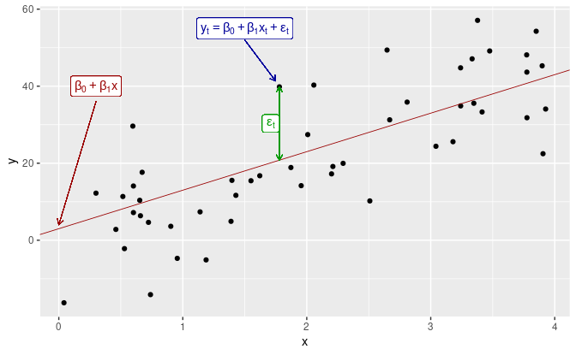
1
Machine Learning: Regression, Clustering, and Classification
Multiple Linear Regression
if there are more than 1 predictor available then it is known as Multiple Linear Regression.
where:
β₁ = coefficient for X₁ variable
β₂ = coefficient for X₂ variable
β₃ = coefficient for X₃ variable and so on…
β₀ is the intercept (constant term). While doing the prediction, there is an error term which is associated with the equation.
The goal of the MLR model is to find the estimated values of β_{0,} β_{1,} β_{2,} β_{3…} by keeping the error term at minimum as possible.

Slide 12

1
Machine Learning: Regression, Clustering, and Classification
Polynomial Regression
Polynomial regression is a non-linear regression. In Polynomial regression, the relationship of the dependent variable is fitted to the nth degree of the independent variable.

Slide 13
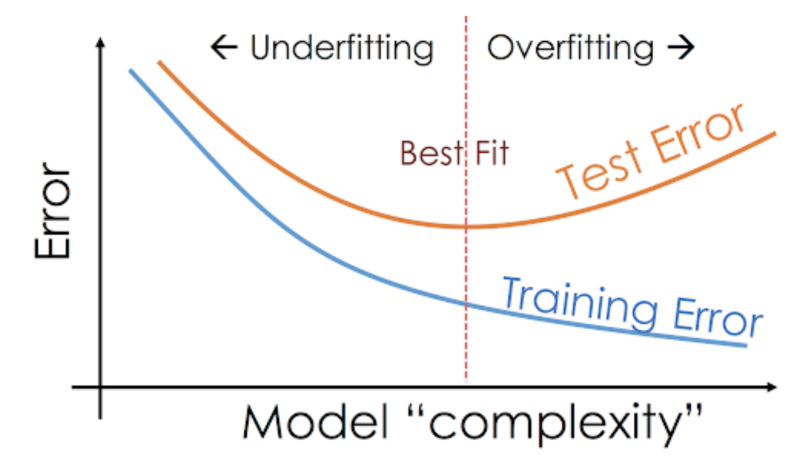
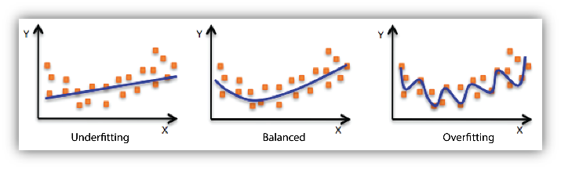
1
Machine Learning: Regression, Clustering, and Classification
Polynomial Regression
When we fit a model, we try to find the optimised, best-fit line, which can describe the impact of the change in the independent variable on the change in the dependent variable by keeping the error term minimum. While fitting the model, there can be 2 events which will lead to the bad performance of the model.
Underfitting
Underfitting is the condition where the model could not fit the data well enough. The under-fitted model leads to low accuracy of the model. Therefore, the model is unable to capture the relationship, trend or pattern in the training data. Underfitting of the model could be avoided by using more data, or by optimising the parameters of the model.
Overfitting
Overfitting is the opposite case of underfitting, i.e., when the model predicts very well on training data and is not able to predict well on test data or validation data. The main reason for overfitting could be that the model is memorising the training data and is unable to generalise it on test/unseen dataset. Overfitting can be reduced by doing feature selection or by using regularisation techniques.

Slide 14
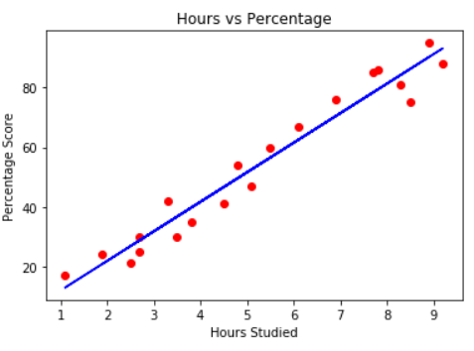
1
Machine Learning: Regression, Clustering, and Classification
Linear Regression in Python
Let's consider a scenario where we want to determine the linear relationship between the numbers of hours a student studies and the percentage of marks that student scores in an exam. We want to find out that given the number of hours a student prepares for a test, about how high of a score can the student achieve?
If we plot the independent variable (hours) on the x-axis and dependent variable (percentage) on the y-axis, linear regression gives us a straight line that best fits the data points, as shown in the figure below.
The y and x variables remain the same, since they are the data features and cannot be changed. The values that we can control are the intercept and slope. There can be multiple straight lines depending upon the values of intercept and slope. Basically, what the linear regression algorithm does is it fits multiple lines on the data points and returns the line that results in the least error.

Slide 15
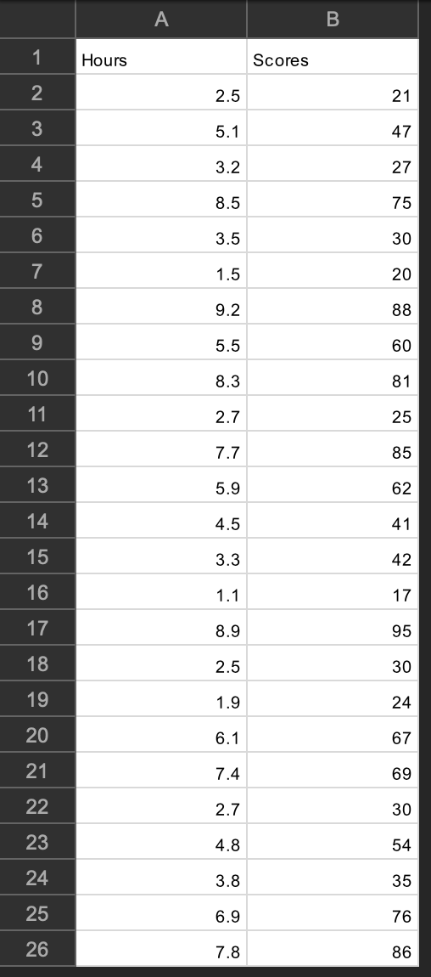
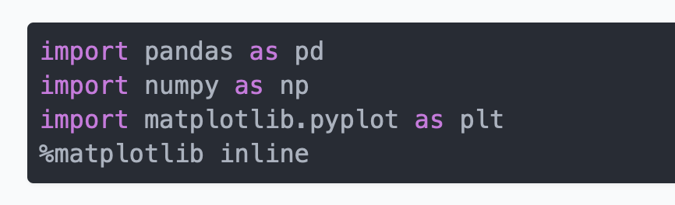
1
Machine Learning: Regression, Clustering, and Classification
Linear Regression in Python
In this section we will see how the Python Scikit-Learn library for machine learning can be used to implement regression functions. We will start with simple linear regression involving two variables and then we will move towards linear regression involving multiple variables.
Importing Libraries
Note: As you may have noticed from the above import statements, this code was executed using a Jupyter Notebook.
type this data in excel sheet and save it as csv format
Dataset
The dataset being used for this example is as follows:
The following command imports the CSV dataset using pandas:

Slide 16
1
Machine Learning: Regression, Clustering, and Classification
Linear Regression in Python
Now let's explore our dataset a bit. To do so, execute the following script:
After doing this, you should see the following printed out:
This means that our dataset has 25 rows and 2 columns. Let's take a look at what our dataset actually looks like. To do this, use the head() method:

Slide 17
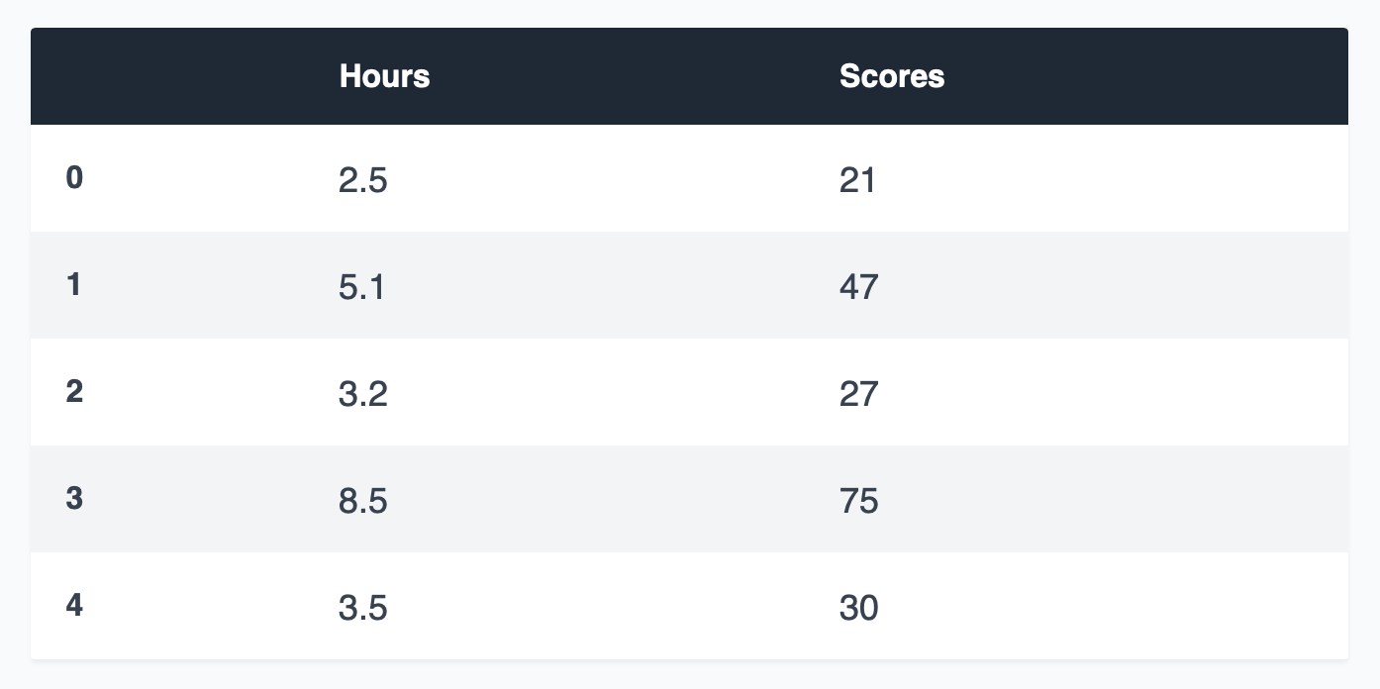
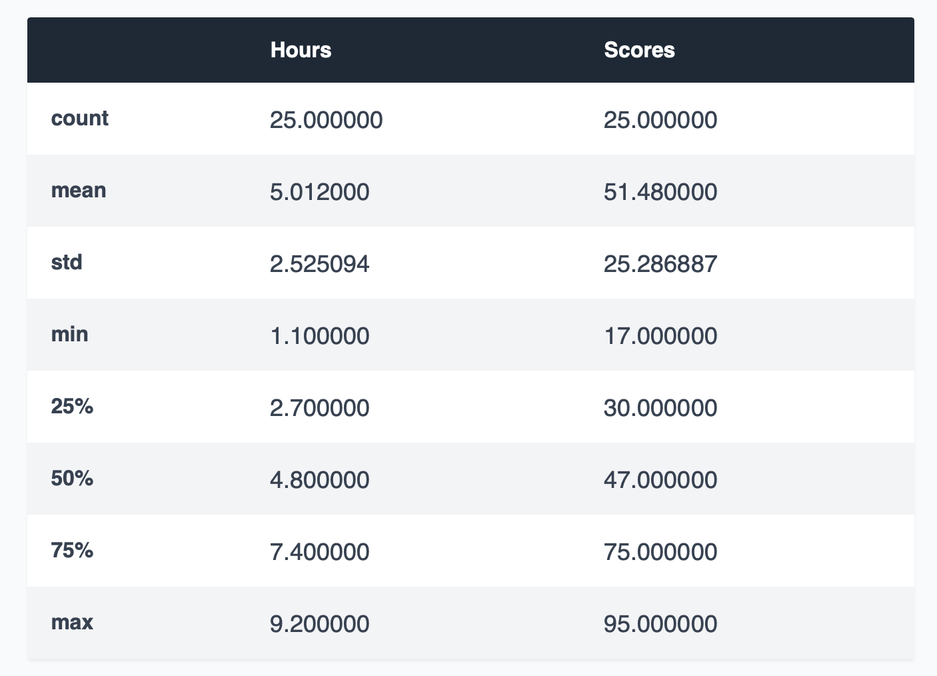
1
Machine Learning: Regression, Clustering, and Classification
Linear Regression in Python
The above method retrieves the first 5 records from our dataset, which will look like this:
To see statistical details of the dataset, we can use describe():

Slide 18
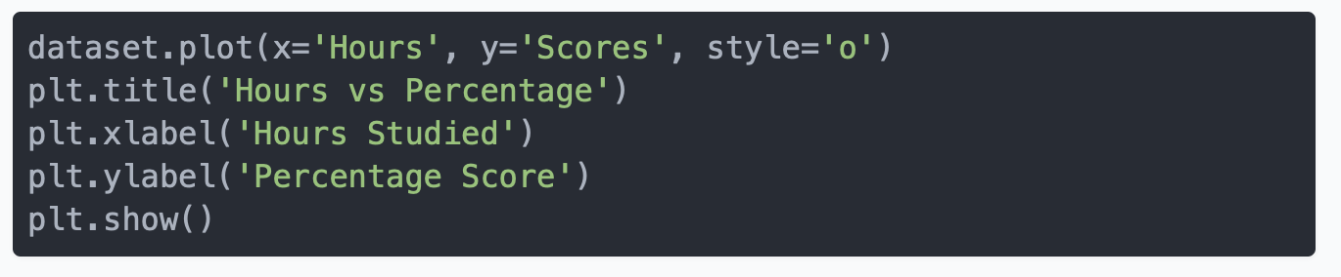
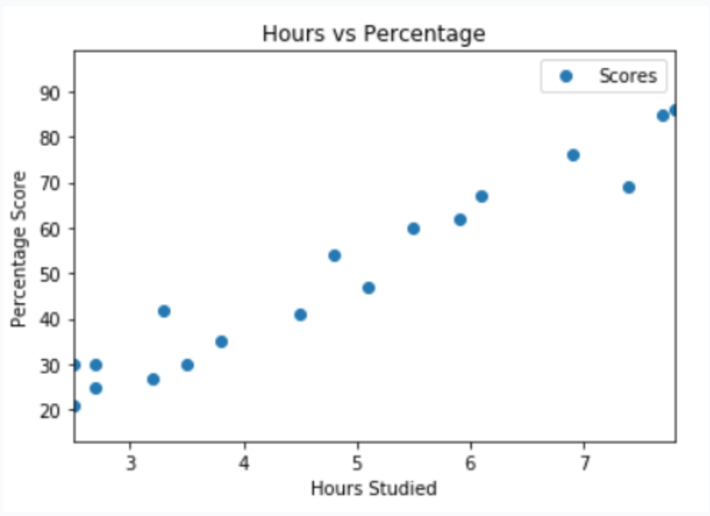
1
Machine Learning: Regression, Clustering, and Classification
Linear Regression in Python
And finally, let's plot our data points on 2-D graph to eyeball our dataset and see if we can manually find any relationship between the data. We can create the plot with the following script:
In the script above, we use plot() function of the pandas dataframe and pass it the column names for x coordinate and y coordinate, which are "Hours" and "Scores" respectively.
The resulting plot will look like this:
From the plot, we can clearly see that there is a positive linear relation between the number of hours studied and percentage of score.

Slide 19
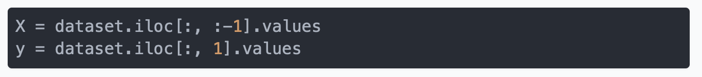
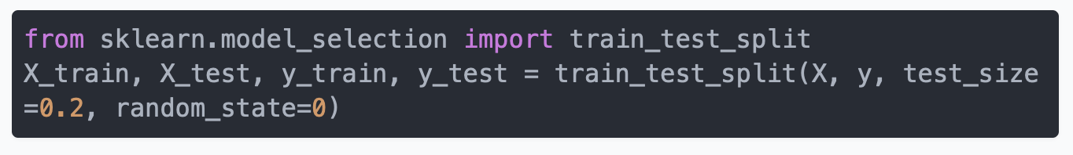
1
Machine Learning: Regression, Clustering, and Classification
Linear Regression in Python
Preparing the Data
In our dataset we only have two columns. We want to predict the percentage score depending upon the hours studied. Therefore, our attribute set will consist of the "Hours" column, and the label will be the "Score" column. To extract the attributes and labels, execute the following script:
The attributes are stored in the X variable. We specified "-1" as the range for columns since we wanted our attribute set to contain all the columns except the last one, which is "Scores". Similarly, the y variable contains the labels. We specified 1 for the label column since the index for "Scores" column is 1. Remember, the column indexes start with 0, with 1 being the second column.
The next step is to split this data into training and test sets. We'll do this by using Scikit-Learn's built-in train_test_split() method:

Slide 20
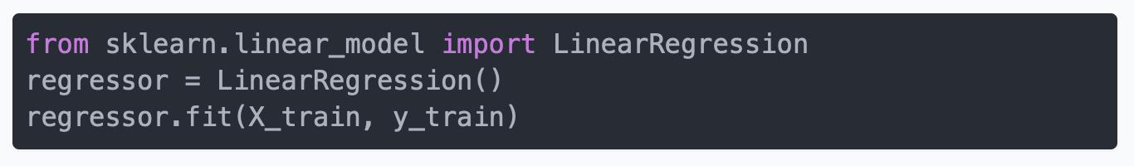
1
Machine Learning: Regression, Clustering, and Classification
Linear Regression in Python
The script splits 80% of the data to training set while 20% of the data to test set. The test_size variable is where we actually specify the proportion of test set.
Training the Algorithm We have split our data into training and testing sets, and now is finally the time to train our algorithm. Execute following command:
With Scikit-Learn it is extremely straight forward to implement linear regression models, as all you really need to do is import the LinearRegression class, instantiate it, and call the fit() method along with our training data

Slide 21
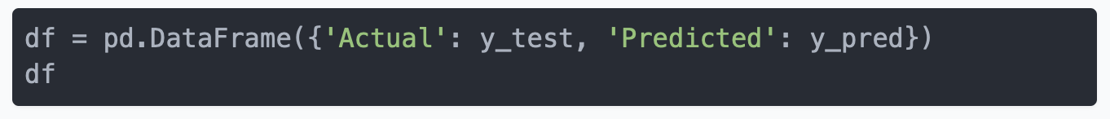
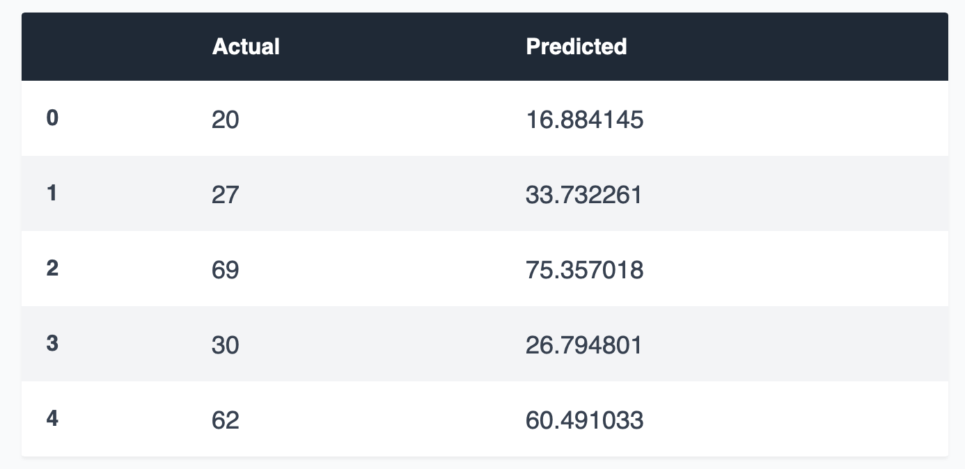
1
Machine Learning: Regression, Clustering, and Classification
Linear Regression in Python
Making Predictions
We will use our test data and see how accurately our algorithm predicts the percentage score. To make pre-dictions on the test data, execute the following script:
The y_pred is a numpy array that contains all the predicted values for the input values in the X_test series.
To compare the actual output values for X_test with the predicted values, execute the following script:
Though our model is not very precise, the predicted percentages are close to the actual ones.
The output looks like this:

Slide 22
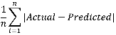
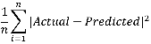
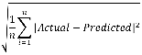
1
Machine Learning: Regression, Clustering, and Classification
Linear Regression in Python
Evaluating the Algorithm
The final step is to evaluate the performance of algorithm. This step is particularly important to compare how well different algorithms perform on a particular dataset. For regression algorithms, three evaluation metrics are commonly used: -Mean Absolute Error (MAE) is the mean of the absolute value of the errors. It is calculated as:
-Mean Squared Error (MSE) is the mean of the squared errors and is calculated as:
-Root Mean Squared Error (RMSE) is the square root of the mean of the squared errors:

Slide 23
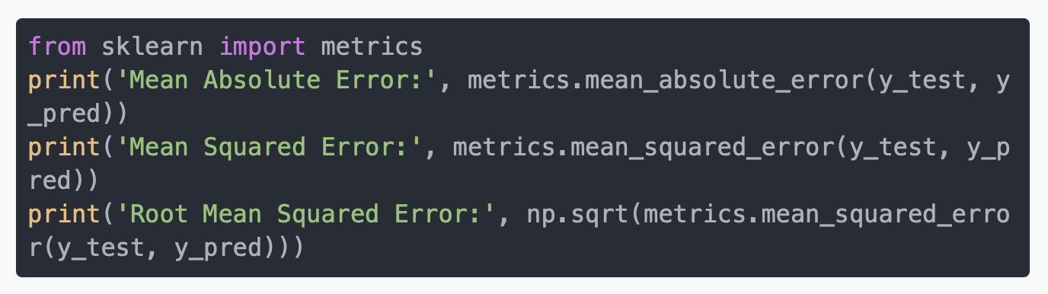
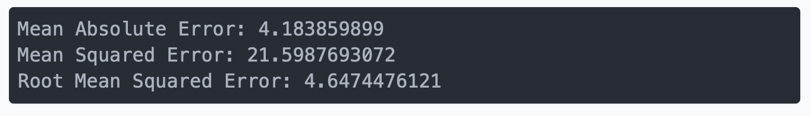
1
Machine Learning: Regression, Clustering, and Classification
Linear Regression in Python
The Scikit-Learn library comes with pre-built functions that can be used to find out these values for us.
Let's find the values for these metrics using our test data. Execute the following code:
The output will look similar to this (but probably slightly different):
You can see that the value of root mean squared error is 4.64, which is less than 10% of the mean value of the percentages of all the students i.e., 51.48. This means that our algorithm did a decent job.

Slide 24
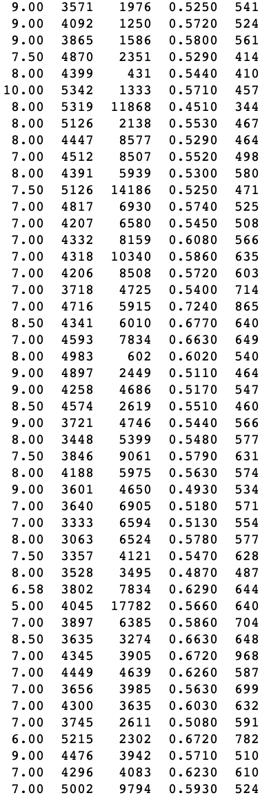
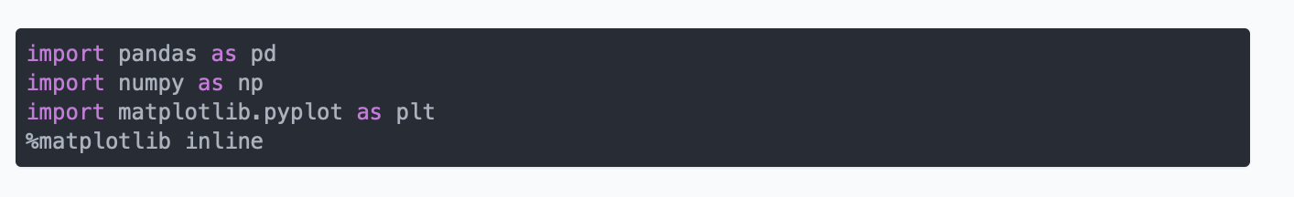
1
Machine Learning: Regression, Clustering, and Classification
Multiple Regression in Python
The steps to perform multiple linear regression are almost similar to that of simple linear regression. The difference lies in the evaluation. You can use it to find out which factor has the highest impact on the predicted output and how different variables relate to each other.
In this section we will use multiple linear regression to predict the gas consumptions (in millions of gallons) in 48 US states based upon gas taxes (in cents), per capita income (dollars), paved highways (in miles) and the proportion of population that has a drivers license.
Importing the Libraries

Slide 25
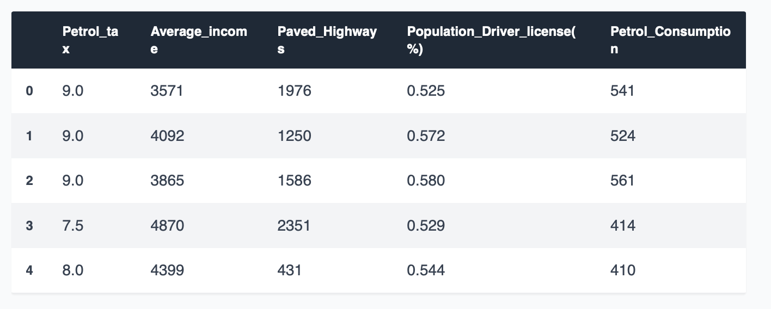
1
Machine Learning: Regression, Clustering, and Classification
Multiple Regression in Python
Dataset
The following command imports the dataset from the csv file:
Just like last time, let's take a look at what our dataset actually looks like. Execute the head() command:
The first few lines of our dataset looks like this:

Slide 26
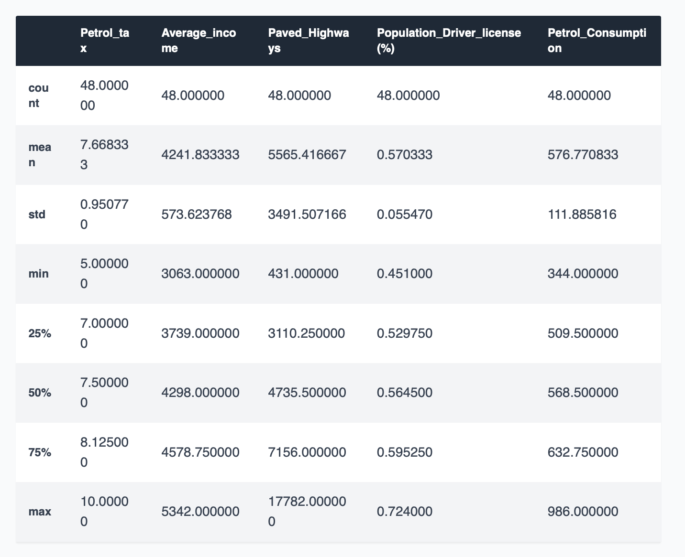
1
Machine Learning: Regression, Clustering, and Classification
Multiple Regression in Python
Dataset
To see statistical details of the dataset, we'll use the describe() command again:

Slide 27
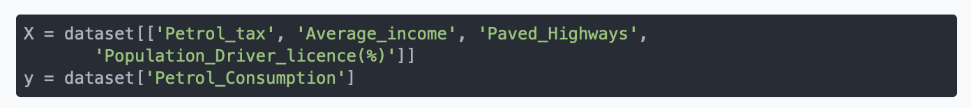
1
Machine Learning: Regression, Clustering, and Classification
Multiple Regression in Python
Preparing the Data
The next step is to divide the data into attributes and labels as we did previously. However, unlike last time, this time around we are going to use column names for creating an attribute set and label. Execute the following script:
Execute the following code to divide our data into training and test sets:

Slide 28
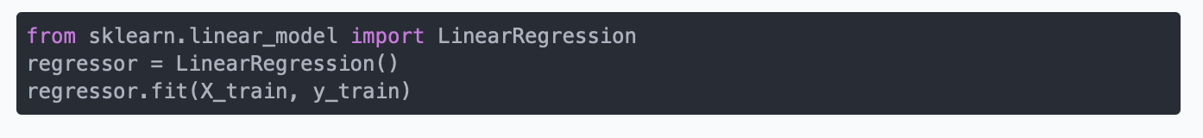
1
Machine Learning: Regression, Clustering, and Classification
Multiple Regression in Python
Training the Algorithm
And finally, to train the algorithm we execute the same code as before, using the fit() method of the LinearRegression class:
Making Predictions
To compare the actual output values for X_test with the predicted values, execute the following script:

Slide 29
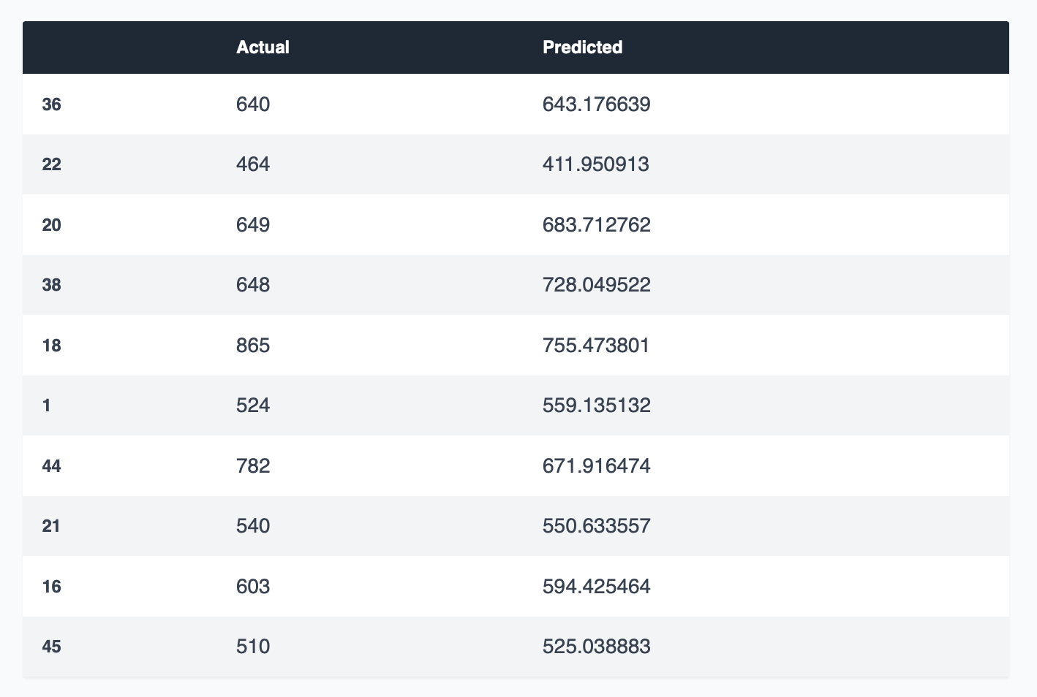
1
Machine Learning: Regression, Clustering, and Classification
Multiple Regression in Python
The output looks like this:

Slide 30
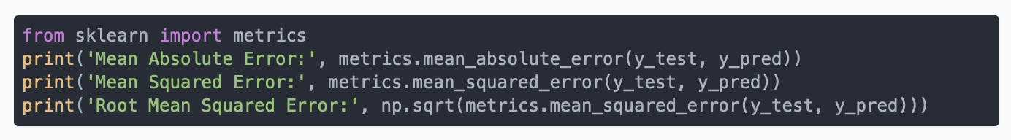
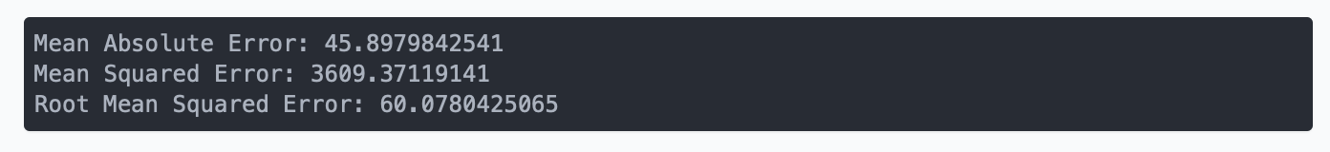
1
Machine Learning: Regression, Clustering, and Classification
Multiple Regression in Python
Evaluating the Algorithm
The final step is to evaluate the performance of algorithm. We'll do this by finding the values for MAE, MSE and RMSE. Execute the following script:
The output will look similar to this:
You can see that the value of root mean squared error is 60.07, which is slightly greater than 10% of the mean value of the gas consumption in all states. This means that our algorithm was not very accurate but can still make reasonably good predictions.

Slide 31
1
Machine Learning: Regression, Clustering, and Classification
Multiple Regression in Python
There are many factors that may have contributed to this inaccuracy, a few of which are listed here:
Need more data: Only one year worth of data isn't that much, whereas having multiple years worth could have helped us improve the accuracy quite a bit.
Bad assumptions: We made the assumption that this data has a linear relationship, but that might not be the case. Visualizing the data may help you determine that.
Poor features: The features we used may not have had a high enough correlation to the values we were trying to predict.

Slide 32
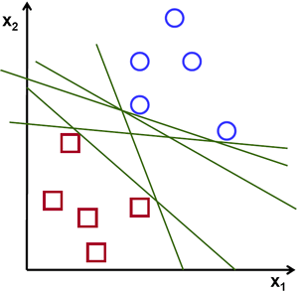

1
Machine Learning: Regression, Clustering, and Classification
Support Vector Machine (SVM)
Support Vector Machine, abbreviated as SVM can be used for both regression and classification tasks. But it is widely used in classification objectives.
Support vector machine is highly preferred by many as it produces significant accuracy with less computation power.
The objective of the support vector machine algorithm is to find a hyperplane in an N-dimensional space(N — the number of features) that distinctly classifies the data points.
To separate the two classes of data points, there are many possible hyperplanes that could be chosen. Our objective is to find a plane that has the maximum margin, i.e the maximum distance between data points of both classes. Maximizing the margin distance provides some reinforcement so that future data points can be classified with more confidence.

Slide 33
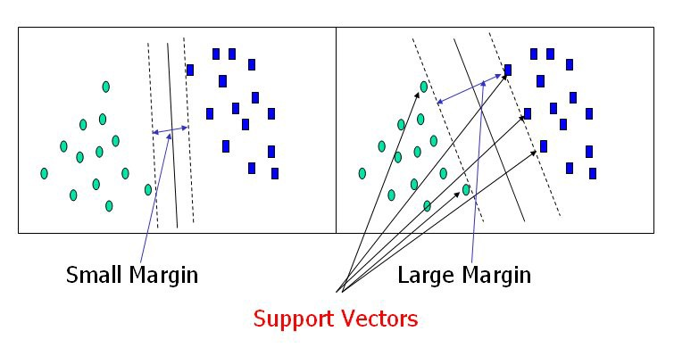

1
Machine Learning: Regression, Clustering, and Classification
Support Vector Machine (SVM)
Hyperplanes are decision boundaries that help classify the data points. Data points falling on either side of the hyperplane can be attributed to different classes.
Support vectors are data points that are closer to the hyperplane and influence the position and orientation of the hyperplane.
Using these support vectors, we maximize the margin of the classifier. Deleting the support vectors will change the position of the hyperplane.

Slide 34


1
Machine Learning: Regression, Clustering, and Classification
Support Vector Machine (SVM)
Cost Function and Gradient Updates
In the SVM algorithm, we are looking to maximize the margin between the data points and the hyperplane. The Hinge loss function that helps maximize the margin is hinge loss.
The cost is 0 if the predicted value and the actual value are of the same sign. If they are not, we then calculate the loss value. We also add a regularization parameter the cost function. The objective of the regularization parameter is to balance the margin maximization and loss.
After adding the regularization parameter, the cost functions looks as below.

Slide 35



1
Machine Learning: Regression, Clustering, and Classification
Support Vector Machine (SVM)
Cost Function and Gradient Updates
Now that we have the loss function, we take partial derivatives with respect to the weights to find the gradients. Using the gradients, we can update our weights.
When there is no misclassification, i.e our model correctly predicts the class of our data point, we only have to update the gradient from the regularization parameter.
When there is a misclassification, i.e our model make a mistake on the prediction of the class of our data point, we include the loss along with the regularization parameter to perform gradient update.

Slide 36


1
Machine Learning: Regression, Clustering, and Classification
Support Vector Machine (SVM)
Dealing with non-linear and inseparable planes
Some problems can’t be solved using linear hyperplane
In such situation, SVM uses a kernel trick to transform the input space to a higher dimensional space as shown on the right. The data points are plotted on the x-axis and z-axis. Now you can easily segregate these points using linear separation.
The SVM algorithm is implemented in practice using a kernel. A kernel transforms an input data space into the required form. SVM uses a technique called the kernel trick. Here, the kernel takes a low-dimensional input space and transforms it into a higher dimensional space. In other words, you can say that it converts nonseparable problem to separable problems by adding more dimension to it.
The Radial basis function kernel is a popular kernel function commonly used in support vector machine classification. RBF can map an input space in infinite dimensional space.

Slide 37
1
Machine Learning: Regression, Clustering, and Classification
Support Vector Machine (SVM)
implementation in Python using scikit-learn.
use the cancer dataset, which is a very famous multi-class classification problem.
The dataset comprises 30 features (mean radius, mean texture, mean perimeter, mean area, mean smoothness, mean compactness, mean concavity, mean concave points, mean symmetry, mean fractal dimension, radius error, texture error, perimeter error, area error, smoothness error, compactness error, concavity error, concave points error, symmetry error, fractal dimension error, worst radius, worst texture, worst perimeter, worst area, worst smoothness, worst compactness, worst concavity, worst concave points, worst symmetry, and worst fractal dimension) and a target (type of cancer).
This data has two types of cancer classes: malignant (harmful) and benign (not harmful). Here, you can build a model to classify the type of cancer. The dataset is available in the scikit-learn library, or you can also download it from the UCI Machine Learning Library.
Scikit dataset: https://scikit-learn.org/stable/modules/generated/sklearn.datasets.load_breast_cancer.html

Slide 38


1
Machine Learning: Regression, Clustering, and Classification
Support Vector Machine (SVM)
Loading Data
Exploring Data
After you have loaded the dataset, you might want to know a little bit more about it. You can check feature and target names.

Slide 39


1
Machine Learning: Regression, Clustering, and Classification
Support Vector Machine (SVM)
Let's explore it for a bit more. You can also check the shape of the dataset using shape.
Let's take a look at the target set.

Slide 40
1
Machine Learning: Regression, Clustering, and Classification
Support Vector Machine (SVM)
Splitting Data
To understand model performance, dividing the dataset into a training set and a test set is a good strategy.
Split the dataset by using the function train_test_split(). you need to pass 3 parameters features, target, and test_set size. Additionally, you can use random_state to select records randomly.
# Import train_test_split function
from sklearn.model_selection import train_test_split # Split dataset into training set and test set X_train, X_test, y_train, y_test = train_test_split(cancer.data, cancer.target, test_size=0.3,random_state=109) # 70% training and 30% test
Generating Model
Let's build support vector machine model. First, import the SVM module and create support vector classifier object by passing argument kernel as the linear kernel in SVC() function. Then, fit your model on train set using fit() and perform prediction on the test set using predict().

Slide 41


1
Machine Learning: Regression, Clustering, and Classification
Support Vector Machine (SVM)
Evaluating the Model
Let's estimate how accurately the classifier or model can predict the breast cancer of patients.
classification rate of 96.49%, considered as very good accuracy.

Slide 42

1
Machine Learning: Regression, Clustering, and Classification
K-Nearest Neighbor (KNN)
KNN is a non-parametric and lazy learning algorithm. Non-parametric means there is no assumption for underlying data distribution.
In other words, the model structure determined from the dataset. This will be very helpful in practice where most of the real-world datasets do not follow mathematical theoretical assumptions.
Lazy algorithm means it does not need any training data points for model generation. All training data used in the testing phase. This makes training faster and testing phase slower and costlier
The KNN algorithm assumes that similar things exist in close proximity. In other words, similar things are near to each other.

Slide 43

1
Machine Learning: Regression, Clustering, and Classification
K-Nearest Neighbor (KNN)
How does the KNN algorithm work?
In KNN, K is the number of nearest neighbours. The number of neighbours is the core deciding factor. K is generally an odd number if the number of classes is 2. When K=1, then the algorithm is known as the nearest neighbour algorithm. This is the simplest case. Suppose P1 is the point, for which label needs to predict. First, you find the one closest point to P1 and then the label of the nearest point assigned to P1.
Suppose P1 is the point, for which label needs to predict. First, you find the k closest point to P1 and then classify points by majority vote of its k neighbours. Each object votes for their class and the class with the most votes is taken as the prediction. For finding closest similar points, you find the distance between points using distance measures such as Euclidean distance, Hamming distance, Manhattan distance and Minkowski distance

Slide 44

1
Machine Learning: Regression, Clustering, and Classification
K-Nearest Neighbor (KNN)
Calculate distance
Find closest neighbor
Vote for labels
Example:
Defining dataset
In this dataset, you have two features (weather and temperature) and one label(play).
# Assigning features and label variables # First Feature weather=['Sunny','Sunny','Overcast','Rainy','Rainy','Rainy','Overcast','Sunny','Sunny', 'Rainy','Sunny','Overcast','Overcast','Rainy'] # Second Feature temp=['Hot','Hot','Hot','Mild','Cool','Cool','Cool','Mild','Cool','Mild','Mild','Mild','Hot','Mild'] # Label or target varible play=['No','No','Yes','Yes','Yes','No','Yes','No','Yes','Yes','Yes','Yes','Yes','No']

Slide 45

1
Machine Learning: Regression, Clustering, and Classification
K-Nearest Neighbor (KNN)
Encoding data columns
Various machine learning algorithms require numerical input data, so you need to represent categorical columns in a numerical column.
In order to encode this data, you could map each value to a number. e.g. Overcast:0, Rainy:1, and Sunny:2.
This process is known as label encoding, and sklearn conveniently will do this for you using Label Encoder. Using this LabelEncoder object, you can fit and transform "weather" column into the numeric column.

Slide 46


1
Machine Learning: Regression, Clustering, and Classification
K-Nearest Neighbor (KNN)
Encoding data columns
Similarly, you can encode temperature and label into numeric columns.
Combining Features
Here, you will combine multiple columns or features into a single set of data using "zip" function

Slide 47

1
Machine Learning: Regression, Clustering, and Classification
K-Nearest Neighbor (KNN)
Generating Model
First, import the KNeighborsClassifier module and create KNN classifier object by passing argument number of neighbors in KNeighborsClassifier() function.
Fit your model on the train set using fit() and perform prediction on the test set using predict().
In the above example, you have given input [0,2], where 0 means Overcast weather and 2 means Mild temperature. Model predicts [1], which means play.

Slide 48


1
Machine Learning: Regression, Clustering, and Classification
K-Nearest Neighbor (KNN)
KNN with Multiple Classes
In this example we will use the wine dataset, which is a very famous multi-class classification problem. The k-Nearest Neighbours algorithm to predict whether the patients in the "Pima Indians Diabetes Dataset" have diabetes or not.
Dataset source: https://www.kaggle.com/uciml/pima-indians-diabetes-database

Slide 49

1
Machine Learning: Regression, Clustering, and Classification
K-Nearest Neighbor (KNN)
the output of the first 5 rows of the dataset
no. | Pregnancies | Glucose | Blood Pressure | Skin Thickness | Insulin | BMI | DiabetesPedigreeFunction | Age | Outcome
0 | 6 | 148 | 72 | 35 | 0 | 33.6 | 0.627 | 50 | 1
1 | 1 | 85 | 66 | 29 | 0 | 26.6 | 0.351 | 31 | 0
2 | 8 | 183 | 64 | 0 | 0 | 23.3 | 0.672 | 32 | 1
3 | 1 | 89 | 66 | 23 | 94 | 28.1 | 0.167 | 21 | 0
4 | 0 | 137 | 40 | 35 | 168 | 43.1 | 2.288 | 33 | 1
As observed above we have 768 rows and 9 columns. The first 8 columns represent the features and the last column represent the target/label.

Slide 50


1
Machine Learning: Regression, Clustering, and Classification
K-Nearest Neighbor (KNN)
Let's split the data randomly into training and test set.
We will fit/train a classifier on the training set and make predictions on the test set. Then we will compare the predictions with the known labels. Scikit-learn provides facility to split data into train and test set using train_test_split method.
Also we create a test set of size of 40% of the dataset.
In [6]:

Slide 51

1
Machine Learning: Regression, Clustering, and Classification
K-Nearest Neighbor (KNN)
create a classifier using k-Nearest Neighbours algorithm.

Slide 52


1
Machine Learning: Regression, Clustering, and Classification
K-Nearest Neighbor (KNN)
Generating plots
We can observe above that we get maximum testing accuracy for k=7. So lets create a KNeighborsClassifier with number of neighbours as 7.

Slide 53



1
Machine Learning: Regression, Clustering, and Classification
K-Nearest Neighbor (KNN)

Slide 54




1
Machine Learning: Regression, Clustering, and Classification
K-Nearest Neighbor (KNN)
Confusion Matrix ( performance evaluation)
A confusion matrix is a table that is used to show the number of correct and incorrect predictions on a classification problem when the real values of the Test Set are known. Scikit-learn provides facility to calculate confusion matrix using the confusion_matrix method.
output of the confusion matrix :
True negative = 165
False positive = 36
True positive = 60
False negative = 47

Slide 55


1
Machine Learning: Regression, Clustering, and Classification
Decision Tree
A decision tree is a flowchart-like structure in which each internal node represents a test on a feature , each leaf node represents a class label (decision taken after computing all features) and branches represent conjunctions of features that lead to those class labels. The paths from root to leaf represent classification rules
if Appetite rank =1, then you need to eat
if a person is modestly hungry, then it is time for a snack

Slide 56


1
Machine Learning: Regression, Clustering, and Classification
Decision Tree
Consider this example of a dataset for 303 heart disease patients
We need to create a decision tree that can predict weather or not a patient has heart disease

Slide 57



1
Machine Learning: Regression, Clustering, and Classification
Decision Tree
We compare each input with the target output

Slide 58


1
Machine Learning: Regression, Clustering, and Classification
Decision Tree
Because none of the leaf nodes are 100% YES Heart Disease, or 100% NO Heart Disease, then they all are considered as impure. Therefore, to measure which separation is the best, we need to measure and compare impurity using the Gini method.

Slide 59



1
Machine Learning: Regression, Clustering, and Classification
Decision Tree
The Gini index is used to determine the split of data:
Where, pi is the probability in each leaf node
We calculate the Gini impurity for the other leaf nodes in the same way then we take the mean average of the total impurities

Slide 60


1
Machine Learning: Regression, Clustering, and Classification
Decision Tree
to calculate the total weighted average of impurities:
We repeat the same process each node as follows:
Good Blood Circulation has the best impurity = 0.360

Slide 61


1
Machine Learning: Regression, Clustering, and Classification
Decision Tree
we separate the data again for the next nodes
Blocked Arteries has lowest impurity

Slide 62


1
Machine Learning: Regression, Clustering, and Classification
Decision Tree
since impurity is low, we keep it as leaf node

Slide 63


1
Machine Learning: Regression, Clustering, and Classification
Decision Tree
Decision Tree Classifier Building in Scikit-learn
Let's first load the required libraries.
Loading Data
Load the required Pima Indian Diabetes dataset using pandas' read CSV function

Slide 64


1
Machine Learning: Regression, Clustering, and Classification
Decision Tree
Feature Selection
divide given columns into two types of variables dependent(or target variable) and independent variable(or feature variables).

Slide 65

1
Machine Learning: Regression, Clustering, and Classification
Decision Tree
Splitting Data
Split the dataset by using function train_test_split(). You need to pass 3 parameters features, target, and test_set size.
# Split dataset into training set and test set X_train, X_test, y_train, y_test = train_test_split(X, y, test_size=0.3, random_state=1) # 70% training and 30% test
Building Decision Tree Model

Slide 66

1
Machine Learning: Regression, Clustering, and Classification
Decision Tree
Evaluating Model
Accuracy can be computed by comparing actual test set values and predicted values.
Well, you got a classification rate of 67.53%, considered as OK accuracy

Slide 67

1
Machine Learning: Regression, Clustering, and Classification
Decision Tree
Visualising Tree Model

Slide 68

1
Machine Learning: Regression, Clustering, and Classification
K-means clustering
A cluster refers to a collection of data points aggregated together because of certain similarities.
A target number k, which refers to the number of centroids you need in the dataset. A centroid is the imaginary or real location representing the centre of the cluster.
The ‘means’ in the K-means refers to averaging of the data; that is, finding the centroid.
First, the K-means starts by randomly selecting centroids, which are used as the beginning points for every cluster, and then performs iterative (repetitive) calculations to optimize the positions of the centroids
This centroid might not necessarily be a member of the dataset.

Slide 69

1
Machine Learning: Regression, Clustering, and Classification
K-means clustering
For measuring the distances, you take the following distance measurement function (also termed as similarity measurement function):
d=|x2–x1|+|y2–y1|+|z2–z1|
This is also known as the Taxicab distance or Manhattan distance, where d is distance measurement between two objects, (x1,y1,z1) and (x2,y2,z2) are the X, Y and Z coordinates of any two objects taken for distance measurement.
The objects are clustered based on their distances between the centroids. An object which has a shorter distance between a centroid (say C1) than the other centroid (say C2) will fall into the cluster of C1.
The algorithm will no longer update the centroids, because there is no change in the current cluster formation, it is the same as the previous formation.

Slide 70

1
Machine Learning: Regression, Clustering, and Classification
K-means clustering
example of cluster formation over multiple iterations with performance rate

Slide 71


1
Machine Learning: Regression, Clustering, and Classification
K-means clustering
Example:
The dataset that we just created consists of 150 randomly generated points that are roughly grouped into three regions with higher density, which is visualized via a two-dimensional scatterplot.
Create a dataset blobs and plot them

Slide 72



1
Machine Learning: Regression, Clustering, and Classification
K-means clustering
The goal is to group the samples based on their feature similarities, which can be achieved using the k-means algorithm that can be summarized by the following four steps:
Randomly pick k centroids from the sample points as initial cluster centres.
Assign each sample to the nearest centroid μ^(j), j ∈ {1, …, k}.
Move the centroids to the centre of the samples that were assigned to it.
Repeat steps 2 and 3 until the cluster assignments do not change or a user-defined tolerance or maximum number of iterations is reached.
Euclidean distance
Sum of Squared Errors (SSE)

Slide 73

1
Machine Learning: Regression, Clustering, and Classification
K-means clustering
Using the preceding code, we set the number of desired clusters to 3. We set n_init=10 to run the k-means clustering algorithms 10 times independently with different random centroids to choose the final model as the one with the lowest SSE. Via the max_iter parameter, we specify the maximum number of iterations for each single run (here, 300).

Slide 74


1
Machine Learning: Regression, Clustering, and Classification
K-means clustering
In the resulting scatterplot, we can see that k-means placed the three centroids at the centre of each sphere, which looks like a reasonable grouping given this dataset.

Slide 75


1
Machine Learning: Regression, Clustering, and Classification
K-means clustering
The elbow method is a useful graphical tool to estimate the optimal number of clusters k for a given task. Intuitively, we can say that, if k increases, the within-cluster SSE (“distortion”) will decrease. This is because the samples will be closer to the centroids they are assigned to.
The idea behind the elbow method is to identify the value of k where the distortion begins to decrease most rapidly, which will become clearer if we plot the distortion for different values of k.
As we can see in the resulting plot, the elbow is located at k = 3, which is evidence that k = 3 is indeed a good choice for this dataset.

Slide 76
2
Summary
Discussed most common regression models with examples
Discussed most common classification models with examples
Discussed most common clustering models with examples
3
Exercise Task
Using the fruit Dataset and Scikit learn library, Implement Decision Tree, KNN, and SVM algorithms. Print each algorithm accuracy and indicate which model is the best-suited for this classification problem.
Hint: https://towardsdatascience.com/solving-a-simple-classification-problem-with-python-fruits-lovers-edition-d20ab6b071d2

Slide 77
THANK YOU
ANY QUESTIONS?

